Slide 1
Universal Service Fund (USF) Programs Presented by Eric Flock

Slide 2
Universal Service Fund Administration
The Universal Service Administrative Company (USAC) was created by the FCC to administer the ~$10 Billion fund.
Focus on universal service to all across the United States.
Programs primarily serve
Rural Areas
Underserved Areas
Difficult-to-Reach Areas

Slide 3
Universal Service Fund Overview
Four Programs
E-Rate
Rural Health Care
Telecommunications Program
Healthcare Connect Fund
High Cost
Lifeline
Connect America Fund

Slide 4
E-Rate

Slide 5
E-Rate Program
Provides discounts to keep students and library patrons connected to broadband and voices services
Category One funding is available for voice services (subject to phasedown), telecommunication services and Internet Access.
Category Two funding is available for hardware, software and services essential for getting broadband to the classroom.

Slide 6
Rural Health Care

Slide 7
Rural Health Care Program
Supports health care facilities in bringing world class medical care to rural areas through increased broadband capabilities
Telecommunications Program
Provides eligible rural Heath Care Providers with discounts for telecommunication services using urban/rural differential
Healthcare Connect Fund
Provides eligible rural Heath Care Providers and consortia with a 65% flat discount on eligible expenses related to broadband connectivity

Slide 8
Health Care Provider Eligibility
Telecommunications Program
Health care providers (HCP)
Must be a not-for-profit entity or a public entity
Must be located in an FCC designated location
Healthcare Connect Fund
Individual rural public/not-for profit HCPs
Consortium of eligible rural and non-rural public/not-for profit /HCPs

Slide 9
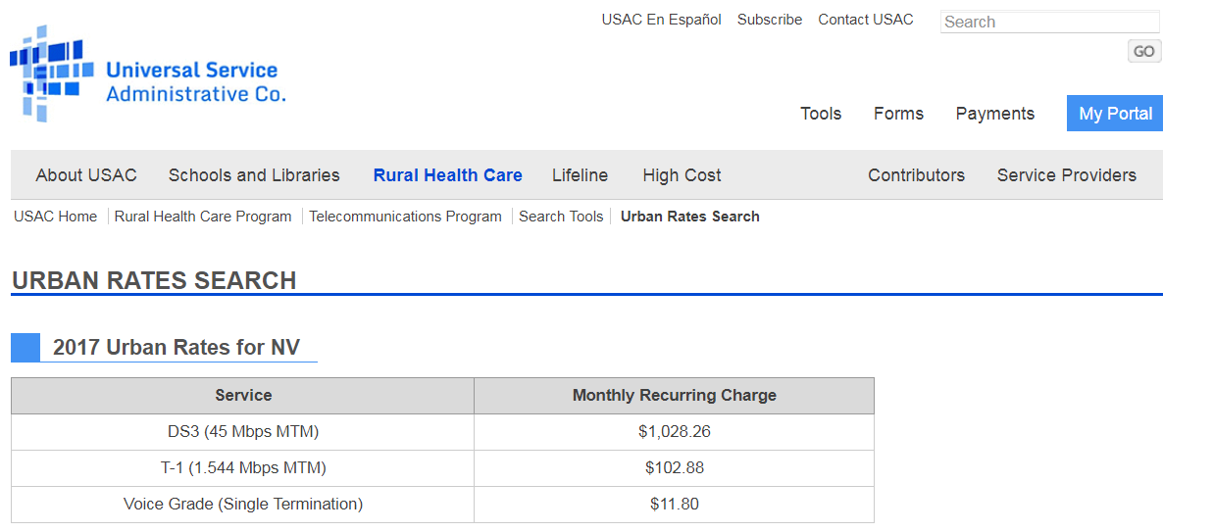
Telecommunications Program
Rural/Urban Differential Example

Slide 10
High Cost

Slide 11
High Cost Program
Provides funding to companies working to expand connectivity infrastructure in unserved and underserved areas
Service Providers must be Eligible Telecommunication Carriers
March 2016 Rate of Reform Order established $20 billion available funds over 10 years

Slide 12
Connect America Fund
Phase II
Provides ongoing support to deploy and maintain fixed-location broadband and voice services in high-cost areas at rates comparable to urban areas
Mobility
Wireless component of the Connect America Fund
Provides ongoing support to deploy and maintain mobile broadband and voice service in high-cost areas

Slide 13
Lifeline

Slide 14
Lifeline
Helps households obtain the voice and broadband connectivity services needed to participate and function in today’s digital world
Discounts are available to those whose income is 135% or less than the federal poverty guidelines.

Slide 15
Federal Poverty Guidelines
Household Size | Income
1 | $16,281
2 | $21,924
3 | $27,567
4 | $33,210
5 | $44,496
6 | $50,139

Slide 16
Plan Qualifications

Slide 17
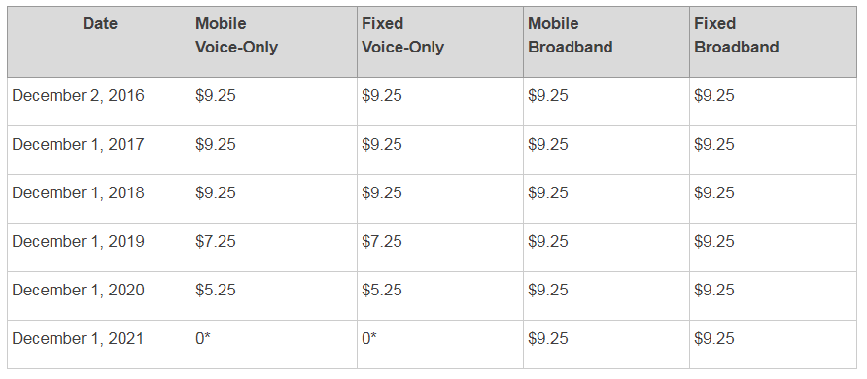
Voice Support Phase-Down

Slide 18
Lifeline Participation

Slide 19
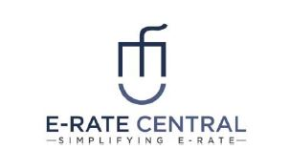
Resources
USAC - https://www.usac.org/default.aspx
Nevada Public Utilities Commission - http://puc.nv.gov/Contact/Contact_Us/
E-Rate Central – http://www.e-ratecentral.com
OSIT - http://osit.nv.gov/

